Slide 1
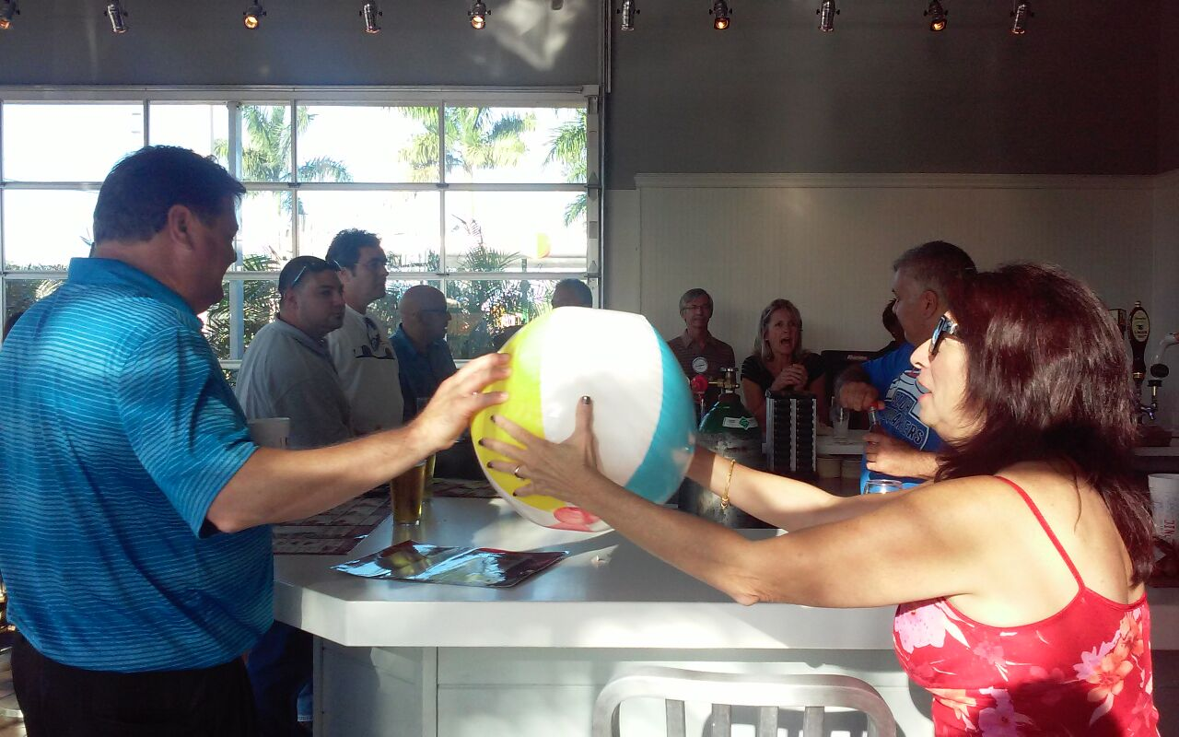
Ilene, Whatever you Do, Don’t Drop the Ball!

Slide 2


Slide 3


Slide 4
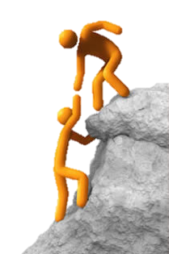
Executive Director’s Challenge:
Target Goal vs Sold
Event | Target | Sold | To Be Sold
Cookbook | 60 | 33 | 27
JM Lexus Expo - Tables | 19 | 3 | 16
Taste of Tamarac - Magazine Pages (no sponsors/editorial) | 25 | 3 | 22
Taste of Tamarac - Expo tables | 15 | 0 | 15
Taste of Tamarac - Food vendors | 30 | 9 | 21
Golf Tournament - Sponsors | 4 | 1 | 3
Golf Tournament - Foursome | 25 | 1 | 24
Golf Tournament - Raffle Prizes | 12 | 1 | 11
Holiday Awards Gala - Sponsors | 3 | 1 | 2
Holiday Awards Gala - Raffle Prizes | 20 | 0 | 20
We Can Climb This Mountain Together

